Slide 1


Building a Hello World APP
By
Hotaru
Web Framework

Slide 2
Hotaru

Slide 3
Hotaru
Simpler syntax,
Similar Performance

Slide 4

Simpler syntax: APP Definition
LApp!(APP = App::new().build());
The Static App Macro

Slide 5
Simpler syntax: APP Definition
LApp!(APP = App::new().build());
Default APP Building
(Default Port localhost:3003)

Slide 6
Simpler syntax: APP Definition
LApp!(APP = App::new().build());
Name the App “APP”

Slide 7
Simpler syntax: Endpoint Reg
Endpoint Wrapper Macro
endpoint!{
APP.url("/"),
/// Hello world function
pub hello_world <HTTP> {
text_response("Hello, world!")
}
}

Slide 8
Simpler syntax: Endpoint Reg
URL Binding to APP
At path “/”
endpoint!{
APP.url("/"),
/// Hello world function
pub hello_world <HTTP> {
text_response("Hello, world!")
}
}

Slide 9
Simpler syntax: Endpoint Reg
Tip: If you don’t want to give a name, change ”pub hello_world” into “_” to make it anonymous
endpoint!{
APP.url("/"),
/// Hello world function
pub hello_world <HTTP> {
text_response("Hello, world!")
}
}
Public endpoint
Named ”hello_world”

Slide 10
Simpler syntax: Endpoint Reg
endpoint!{
APP.url("/"),
/// Hello world function
pub hello_world <HTTP> {
text_response("Hello, world!")
}
}
Say it explicitly:
This is an HTTP protocol

Slide 11
Simpler syntax: Endpoint Reg
endpoint!{
APP.url("/"),
/// Hello world function
pub hello_world <HTTP> {
text_response("Hello, world!")
}
}
Return “Hello, world!”
HTML String

Slide 12
Simpler syntax: Running our APP!
use hotaru::prelude::*;
use hotaru::http::*;
#[tokio::main]
async fn main() {
APP.clone().run().await;
}
Import the Core and HTTP section of Hotaru

Slide 13
Simpler syntax: Running our APP!
use hotaru::prelude::*;
use hotaru::http::*;
#[tokio::main]
async fn main() {
APP.clone().run().await;
}
Tokio async runtime in main()
Note you should not set the worker number here. Do that in APP init

Slide 14
Simpler syntax: Running our APP!
Note:
The run function will generate the number of workers you specified in APP configuration
use hotaru::prelude::*;
use hotaru::http::*;
#[tokio::main]
async fn main() {
APP.clone().run().await;
}
Clone the Arc APP
And run run() function

Slide 15
use hotaru::prelude::*;
use hotaru::http::*;
#[tokio::main]
async fn main() {
APP.clone().run().await;
}
LApp!(APP = App::new().build());
endpoint!{
APP.url("/"),
/// Hello world function
pub hello_world <HTTP> {
text_response("Hello, world!")
}
}
mod resource;
The Full Hello World APP!
Try to run it and visit localhost:3003/ !
[package]
name = "hotaru_hello"
version = "0.1.0"
edition = "2024"
[dependencies]
hotaru = "0.7.6"
ctor = "0.4.0"
tokio = { version = "1", features = ["full"] }

Slide 16
AND…

Slide 17
AND…
New
Multi-Protocol Support
Intuitive Middleware

Slide 18
Let’s build a
Harder APP

Slide 19
Middleware definition
middleware!{
pub Logger <HTTP> {
println!(”Request path: {}", req.path());
next(req).await
}
}
Middleware Macro

Slide 20
Middleware definition
middleware!{
pub Logger <HTTP> {
println!(”Request path: {}", req.path());
next(req).await
}
}
Public Middleware,
Named Logger

Slide 21
Middleware definition
middleware!{
pub Logger <HTTP> {
println!(”Request path: {}", req.path());
next(req).await
}
}
Still, we explicitly say it is for HTTP

Slide 22
Middleware definition
middleware!{
pub Logger <HTTP> {
println!(”Request path: {}", req.path());
next(req).await
}
}
All the information of the request user send, is in the ”req” var

Slide 23
Middleware definition
middleware!{
pub Logger <HTTP> {
println!(”Request path: {}", req.path());
next(req).await
}
}
Get the URL path of the request.
Please see our full doc if you want to learn the API for req.

Slide 24
Middleware definition
middleware!{
pub Logger <HTTP> {
println!(”Request path: {}", req.path());
next(req).await
}
}
Print the path out

Slide 25
Middleware definition
middleware!{
pub Logger <HTTP> {
println!(”Request path: {}", req.path());
next(req).await
}
}
Pass the request through the middleware chain, and return it

Slide 26
Integration with endpoint
endpoint!{
APP.url("/<str:name>"),
middleware = [Logger],
/// Hello world function
pub hello_world <HTTP> {
let name = req.pattern("name")
.unwrap_or(”N/A”
.to_string());
akari_render!(
"index.html",
name = name
)
}
}
We change the binding.
Now user can visit the URL “/(any string)”

Slide 27
Integration with endpoint
endpoint!{
APP.url("/<str:name>"),
middleware = [Logger],
/// Hello world function
pub hello_world <HTTP> {
let name = req.pattern("name")
.unwrap_or(”N/A”
.to_string());
akari_render!(
"index.html",
name = name
)
}
}
Add Logger into the middleware chain
Refer to full doc to see “[..]” pattern and middleware inheritance

Slide 28
Integration with endpoint
endpoint!{
APP.url("/<str:name>"),
middleware = [Logger],
/// Hello world function
pub hello_world <HTTP> {
let name = req.pattern("name")
.unwrap_or(”N/A”
.to_string());
akari_render!(
"index.html",
name = name
)
}
}
Get the ”name” field in the URL

Slide 29
Integration with endpoint
endpoint!{
APP.url("/<str:name>"),
middleware = [Logger],
/// Hello world function
pub hello_world <HTTP> {
let name = req.pattern("name")
.unwrap_or(”N/A”
.to_string());
akari_render!(
"index.html",
name = name
)
}
}
Render the file template/index.html

Slide 30
Integration with endpoint
endpoint!{
APP.url("/<str:name>"),
middleware = [Logger],
/// Hello world function
pub hello_world <HTTP> {
let name = req.pattern("name")
.unwrap_or(”N/A”
.to_string());
akari_render!(
"index.html",
name = name
)
}
}
Pass name into the template

Slide 31
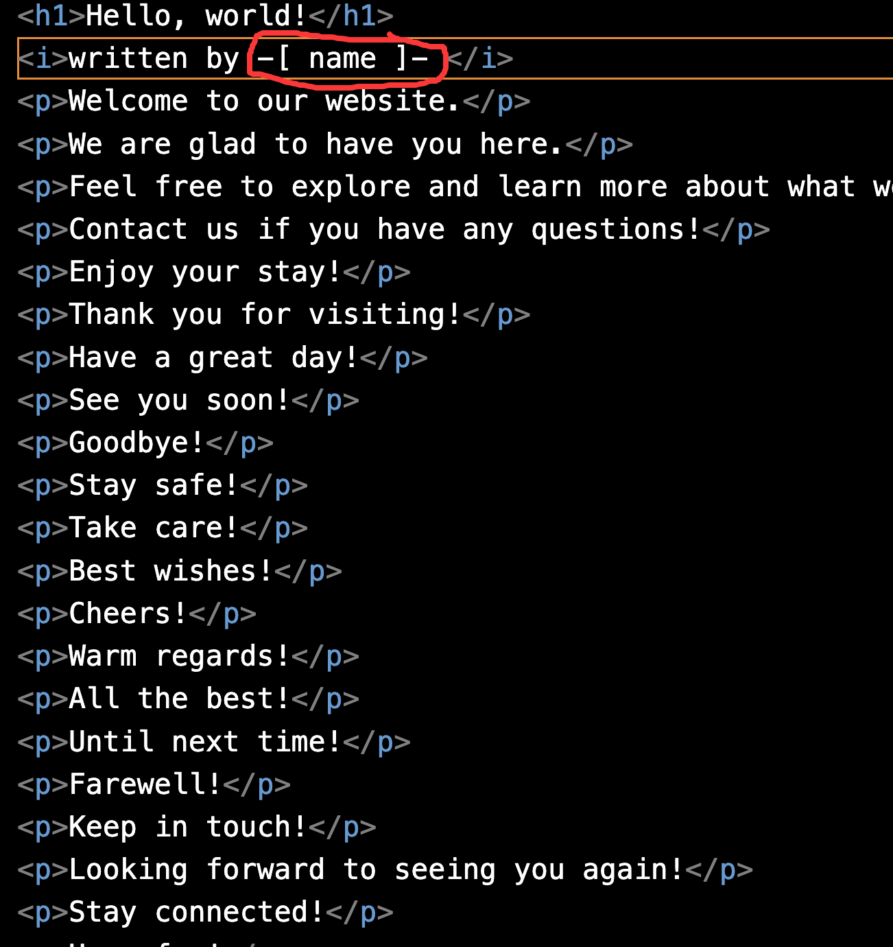
Main.rs templates/index.html
use hotaru::prelude::*;
use hotaru::http::*;
#[tokio::main]
async fn main() {
APP.clone().run().await;
}
LApp!(APP = App::new().binding("127.0.0.1:3003").build());
endpoint!{
APP.url("/<str:name>"),
middleware = [Logger],
/// Hello world function
pub hello_world <HTTP> {
let name = req.pattern("name").unwrap_or(”N/A".to_string());
akari_render!(
"index.html",
name = name
)
}
}
middleware!{
pub Logger <HTTP> {
println!("This is a log where request path: {}", req.path());
next(req).await
}
}
mod resource;

Slide 32
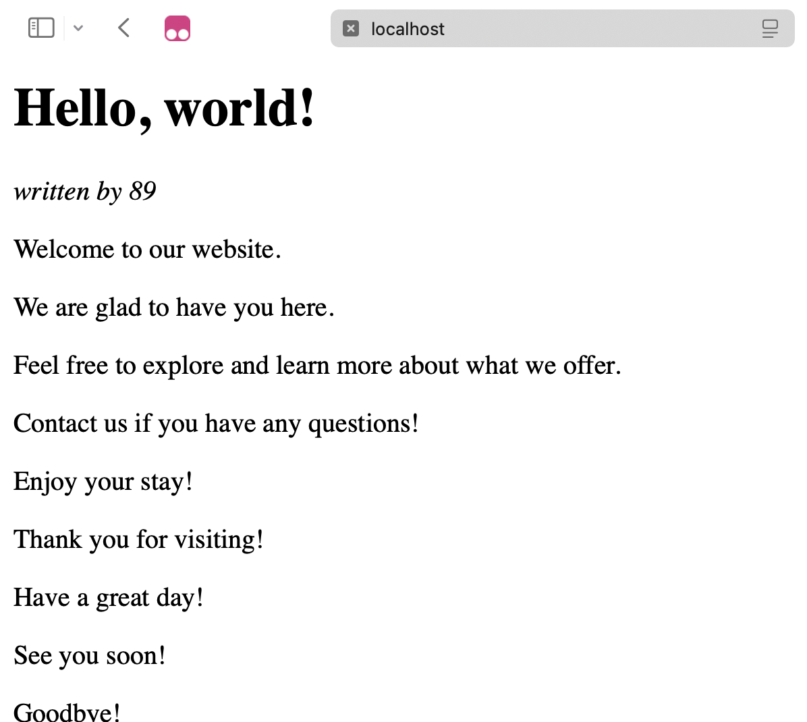
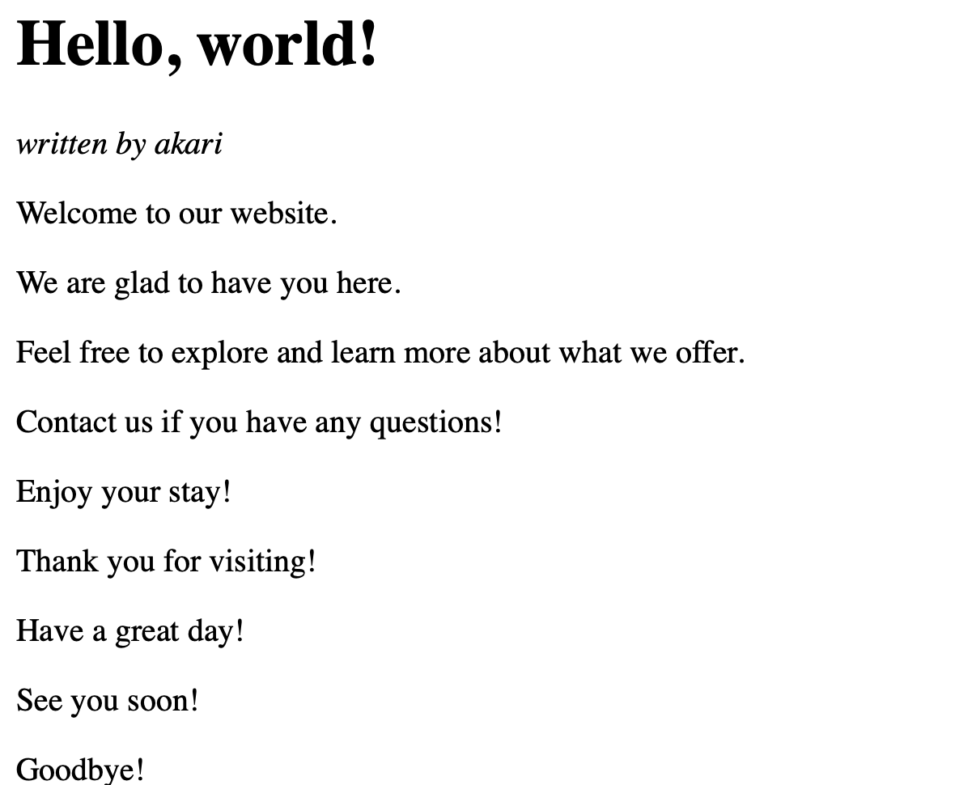
Localhost:3003/89 Localhost:3003/akari

Slide 33
Thanks for watching!

